Slide 1
Chapter 5: Everything Needs to be Secured
Vịnh Nguyễn
Introduction to the Internet of Things v2.0
Notes:
Cisco Networking Academy Program
Introduction to the Internet of Things v2.0
Chapter 5: Everything Needs to be Secured

Slide 2
Instructor Materials – Chapter 5 Planning Guide
This PowerPoint deck is divided in two parts:
Instructor Planning Guide
Information to help you become familiar with the chapter
Teaching aids
Instructor Class Presentation
Optional slides that you can use in the classroom
Begins on slide # 9
Note: Remove the Planning Guide from this presentation before sharing with anyone.
Notes:
2

Slide 3
Chapter 5: Everything Needs to be Secured
Introduction to the Internet of Things v2.0 Planning Guide
Notes:
Cisco Networking Academy Program
Introduction to the Internet of Things
Chapter 5: Everything Needs to be Secured.

Slide 4
Chapter 5: Activities
What activities are associated with this chapter?
Page # | Activity Type | Activity Name
5.1.1.2 | Lab | Types of Data
5.1.1.4 | Activity | Data in the Wrong Hands
5.1.1.5 | Lab | Internet Fingerprint
5.1.2.3 | Activity | Challenges of Securing IoT
5.1.2.5 | Activity | Protecting Devices
5.1.2.6 | Packet Tracer | Configure Wireless Security
5.1.2.7 | Activity | Topic Assessment
5.1.3.1 | Activity | How to Protect your Personal Data
5.1.3.2 | Activity | Strong Passwords
5.1.3.6 | Lab | Discover Your Own Risky Online Behavior
Notes:
4

Slide 5
Chapter 5: Assessment
Students should complete Chapter 5, “Assessment” after completing Chapter 5.
Quizzes, labs, topic assessments and other activities can be used to informally assess student progress.
Notes:
5

Slide 6
Chapter 5: Best Practices
Prior to teaching Chapter 5, the instructor should:
Complete Chapter 5 Quiz
Preview the labs, videos and activities.
Discuss the kinds of security students have implemented in their homes and/or on their personal devices.
Discuss the results of the risky behaviors lab.
Notes:
6

Slide 7
Chapter 5: Additional Help
For additional help with teaching strategies, including lesson plans, analogies for difficult concepts, and discussion topics, visit the Community Forums .
If you have lesson plans or resources that you would like to share, upload them to the Community Forums in order to help other instructors.
Students can enroll in Introduction to Packet Tracer (self-paced).
Notes:
7

Slide 9
Chapter 5: Everything Needs to be Secured
Introduction to the Internet of Things v2.0
Notes:
Cisco Networking Academy Program
Introduction to the Internet of Things
Chapter 5: Everything Generates Data

Slide 10
Chapter 5 - Sections & Objectives
5.1 Security in the Digitized World
Explain why security is important in the digitized world.
Explain the need for security in the digitized world.
Explain how to help secure the corporate world.
Explain how to secure personal data and devices.
Notes:
10
Cisco Networking Academy Program
Introduction to the Internet of Things
Chapter 5: Everything Needs to be Secured

Slide 11
5.1 Security in the Digitized World
Notes:
5 – Everything Needs to be Secured
5.1 – Security in the Digitized World

Slide 12
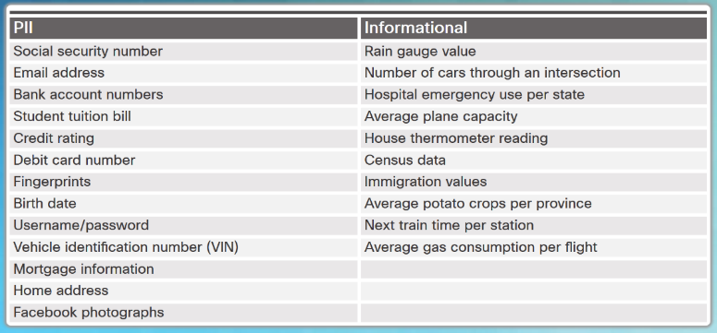
Why is Security so Important? Types of Data
The quantity, volume, variety, and immediacy of generated data has changed.
Personally identifiable information (PII) or sensitive personal information (SPI) is data relating to a living individual that can be used on its own or with other information to identify, contact, or locate a specific individual.
Informational data can also contain sensitive information concerning corporate secrets, new product patents, or national security.
Notes:
5.1 – Security in the Digitized World
5.1.1 – Why is Security so Important?
5.1.1.1 – Types of Data

Slide 13
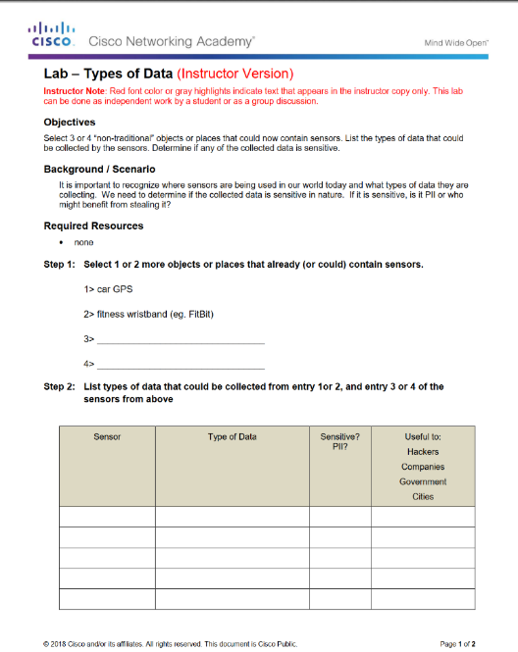
Why is Security so Important? Lab – Types of Data
Notes:
5.1 – Security in the Digitized World
5.1.1 – Why is Security so Important?
5.1.1.2 – Lab- Types of Data

Slide 14

Why is Security so Important? Who Wants our Data?
The Good Guys
Legitimate companies that have an agreement in place to use the collected data about you.
We agree to this in “Terms and Conditions” or “Terms of Service and Agreements”
White hat hackers who test security to help protect data.
The Bad Guys
Black hat hackers, want access to collected data for many nefarious reasons:
To access user IDs and passwords to steal identities
To access data to commit a crime.
To sell the information to a third party.
To modify the data or disable functionality on a device.
To disrupt or to damage the image of a legitimate company.
To create political unrest or to make a political statement.
Notes:
5.1 – Security in the Digitized World
5.1.1 – Why is Security so Important?
5.1.1.3 – Who Wants our Data?

Slide 15

Why is Security so Important? Data in the Wrong Hands
Login credentials and other personal data for more than one Million Yahoo and Gmail accounts are reportedly being offered for sale on the dark web.
Cybercriminals penetrated Equifax (EFX), one of the largest credit bureaus, in July 2017 and stole the personal data of 145 million people
A breach of MyFitnessPal affected 150 million users.
Ransomware attackers stole 57 million drivers and rider accounts from Uber.
Notes:
5.1 – Security in the Digitized World
5.1.1 – Why is Security so Important?
5.1.1.4 – Data in the Wrong Hands

Slide 16
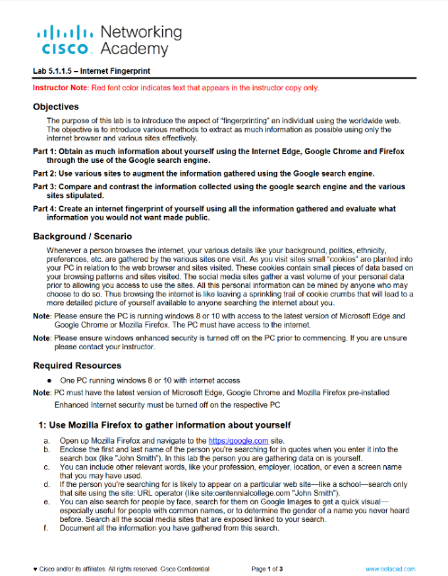
Why is Security so Important? Lab – Internet Fingerprint
Notes:
5.1 – Security in the Digitized World
5.1.1 – Why is Security so Important?
5.1.1.5 – Lab – Internet Fingerprint

Slide 17
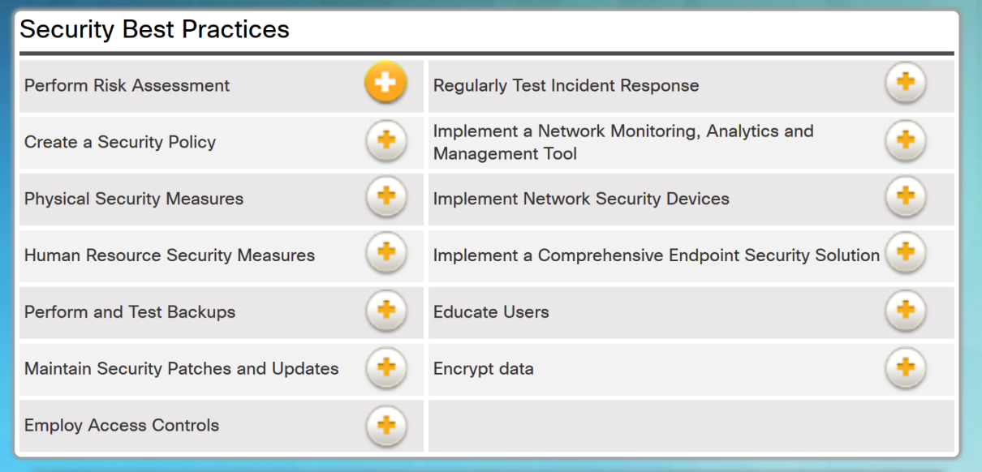
Why is Security so Important? Security Best Practices
Notes:
5.1 – Security in the Digitized World
5.1.2 – Protecting the Corporate world
5.1.2.1 – Security Best Practices

Slide 18
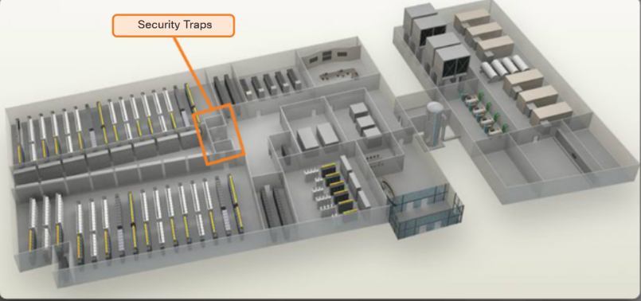
Protecting the Corporate World Physical Security
Outside perimeter security - on-premise security officers, fences, gates, continuous video surveillance, and security breach alarms.
Inside perimeter security - continuous video surveillance, electronic motion detectors, security traps, and biometric access and exit sensors.
Notes:
5.1 – Security in the Digitized World
5.1.2 – Protecting the Corporate World
5.1.2.2 – Physical Security

Slide 19

Protecting the Corporate World Challenges of Securing IoT Devices
Increasing Number of Devices - The number of interconnected sensors and smart devices is growing exponentially, increasing the opportunity for attacks.
Non-Traditional Location of Devices - Some connected IoT devices are able to interact with the physical world.
Lack of Upgradeability - IoT sensor-enabled devices may be located in remote and/or inaccessible locations where human intervention or configuration is almost impossible.
Notes:
5.1 – Security in the Digitized World
5.1.2 – Protecting the Corporate World
5.1.2.3 – Challenges of Securing IoT Devices

Slide 20
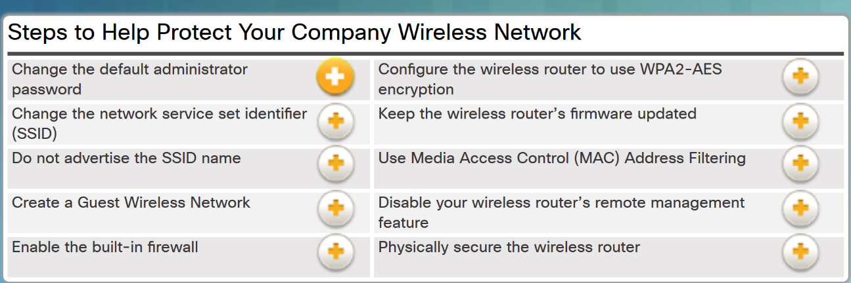
Protecting the Corporate World Safe Wi-Fi Usage
Notes:
5.1 – Security in the Digitized World
5.1.2 – Protecting the Corporate World
5.1.2.4 – Safe Wi-Fi Usage

Slide 21
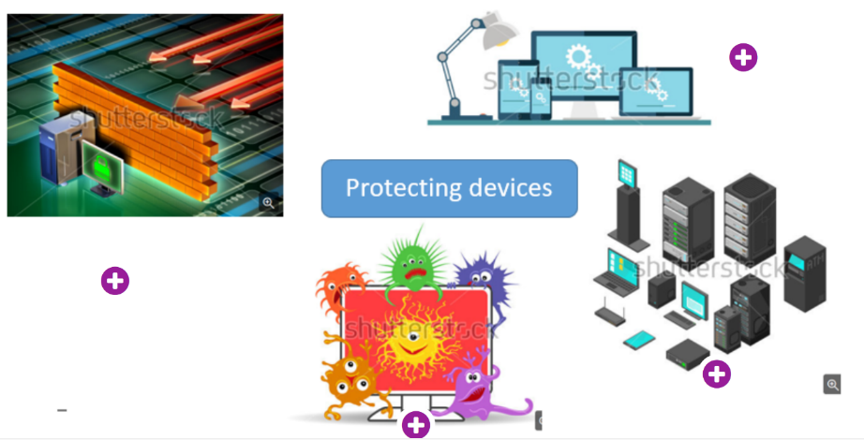
Protecting the Corporate World Protecting Devices
Keep the Firewall On
Manage Your Operating System and Browser
Protect All Your Devices
Use Antivirus and Antispyware
Notes:
5.1 – Security in the Digitized World
5.1.2 – Protecting the Corporate World
5.1.2.5 – Protecting Devices

Slide 22
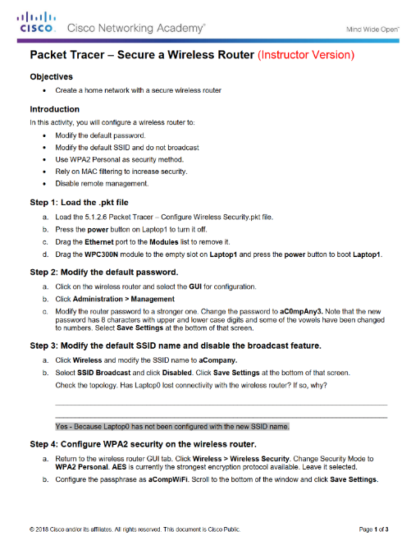
Protecting the Corporate World Packet Tracer – Secure a Wireless Router
Notes:
5.1 – Security in the Digitized World
5.1.2 – Protecting the Corporate World
5.1.2.6 – Packet Tracer – Secure a Wireless Router
5.1.2.7 – Topic Assessment
5.1.3.1 – Activity – How to Protect your Personal Data
5.1.3.2 – Activity – Strong passwords

Slide 23
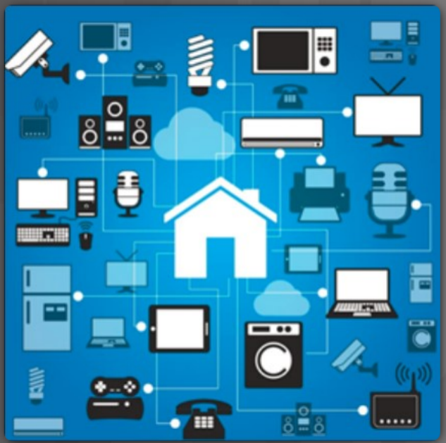
Securing Personal Data and Devices Smart Homes
Smart sensors in our homes increase the potential for security issues.
The sensors could provide a way for hackers to get into our home network and gain access to any PCs and data that are connected to it.
Before purchasing home security systems, it is very important to research the developer and the security and encryption protocols that are in place for its products.
Notes:
5.1 – Security in the Digitized World
5.1.3 – Securing Personal Data and Devices
5.1.3.3 – Smart Homes

Slide 24
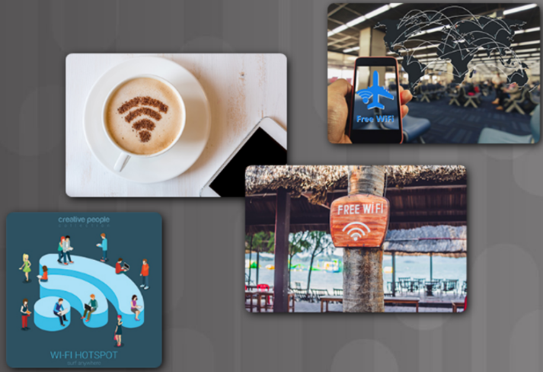
Securing Personal Data and Devices Public Hotspots
Safety rules to follow when using a public or unsecure Wi-Fi hotspot:
Do not access or send any sensitive personal information
Verify that your computer is configured with file and media sharing, and that it requires user authentication with encryption.
Use encrypted virtual private network (VPN) tunnels and services.
Bluetooth can be exploited by hackers to eavesdrop on some devices, establish remote access controls, distribute malware, and drain batteries.
Turn off when not in use.
Notes:
5.1 – Security in the Digitized World
5.1.3 – Securing Personal Data and Devices
5.1.3.4 – Public Hotspots

Slide 25
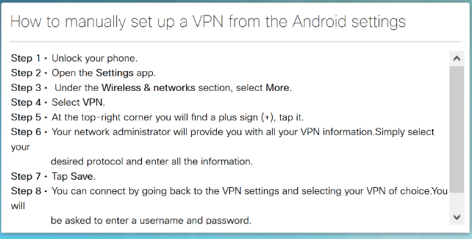
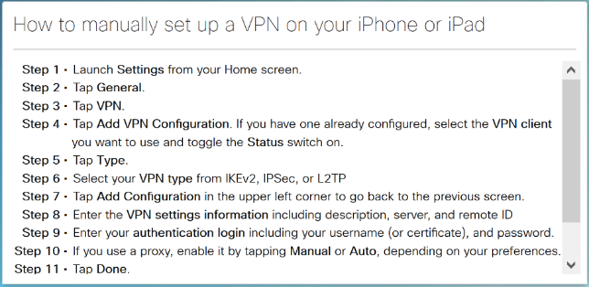
Securing Personal Data and Devices Setting up a VPN on Smartphones
Notes:
5.1 – Security in the Digitized World
5.1.3 – Securing Personal Data and Devices
5.1.3.5 – Setting up a VPN on Smartphones

Slide 26
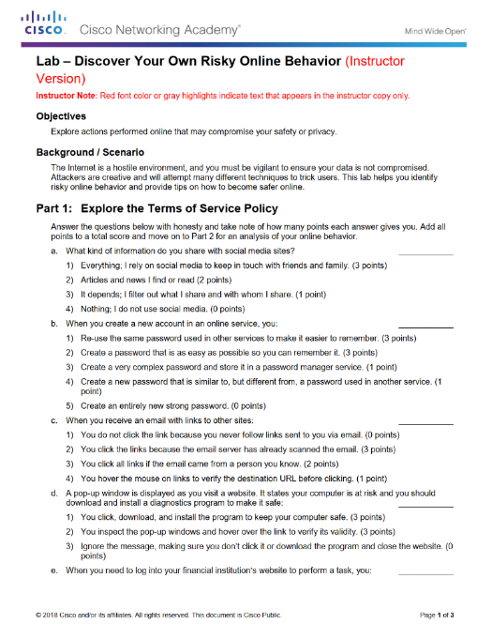
Securing Personal Data and Devices Lab - Discover Your Own Risky Online Behavior
Notes:
5.1 – Security in the Digitized World
5.1.3 – Securing Personal Data and Devices
5.1.3.6 – Lab - Discover Your Own Risky Online Behavior

Slide 27
5.2 Chapter Summary
Notes:
5 – Everything Needs to be Secured
5.2 - Summary

Slide 28
Chapter Summary Summary
The quantity, volume, variety, and immediacy of generated data has changed.
Personally identifiable information (PII) or sensitive personal information (SPI) is data relating to a living individual that can be used on its own or with other information to identify, contact, or locate a specific individual.
Informational data can also contain sensitive information concerning corporate secrets, new product patents, or national security.
White hat hackers test security to help protect data.
Black hat hackers, want access to collected data for many nefarious reasons.
Outside perimeter security - on-premise security officers, fences, gates, continuous video surveillance, and security breach alarms.
Inside perimeter security - continuous video surveillance, electronic motion detectors, security traps, and biometric access and exit sensors.
Notes:
5 – Everything Needs to be Secured
5.2 – Summary

Slide 29
Chapter Summary Summary (Cont.)
Challenges of securing devices on the IoT:
Increasing Number of Devices - The number of interconnected sensors and smart devices is growing exponentially, increasing the opportunity for attacks.
Non-Traditional Location of Devices - Some connected IoT devices are able to interact with the physical world.
Lack of Upgradeability - IoT sensor-enabled devices may be located in remote and/or inaccessible locations where human intervention or configuration is almost impossible.
Know the steps to protect your company’s wireless network.
Steps for protecting your own devices:
Keep the Firewall On
Manage Your Operating System and Browser
Protect All Your Devices
Use Antivirus and Antispyware
Notes:
5 – Everything Needs to be Secured
5.2 – Summary

Slide 30
Chapter Summary Summary (Cont.)
Smart sensors in our homes increase the potential for security issues.
Safety rules to follow when using a public or unsecure Wi-Fi hotspot:
Do not access or send any sensitive personal information
Verify that your computer is configured with file and media sharing, and that it requires user authentication with encryption.
Use encrypted virtual private network (VPN) tunnels and services.
Set up a VPN on your smart phone.
Notes:
5 – Everything Needs to be Secured
5.2 – Summary

